Slide 1
Concept Generation
Teaching materials to accompany:
Product Design and Development
Chapter 7
Karl T. Ulrich and Steven D. Eppinger
5th Edition, Irwin McGraw-Hill, 2012.

Slide 2

Product Design and Development
Karl T. Ulrich and Steven D. Eppinger
5th edition, Irwin McGraw-Hill, 2012.
Chapter Table of Contents:
Introduction
Development Processes and Organizations
Opportunity Identification
Product Planning
Identifying Customer Needs
Product Specifications
Concept Generation
Concept Selection
Concept Testing
Product Architecture
Industrial Design
Design for Environment
Design for Manufacturing
Prototyping
Robust Design
Patents and Intellectual Property
Product Development Economics
Managing Projects

Slide 3
Concept Development Process
Mission
Statement
Identify
Customer
Needs
Establish
Target
Specifications
Generate
Product
Concepts
Select
Product
Concept(s)
Test
Product
Concept(s)
Set
Final
Specifications
Plan
Downstream
Development
Development
Plan
Perform Economic Analysis
Benchmark Competitive Products
Build and Test Models and Prototypes

Slide 4
Outline
Product concept, definition
Commonly dysfunctions in product development
Five steps in the product concept generation process

Slide 5
Product concept
A technical description of how the product will satisfy the customer’s needs
An approximate description of
  the technology,
  working principles, and
  form of the product
Often expressed with a sketch or 3D model, accompanied with a brief textual description.

Slide 6
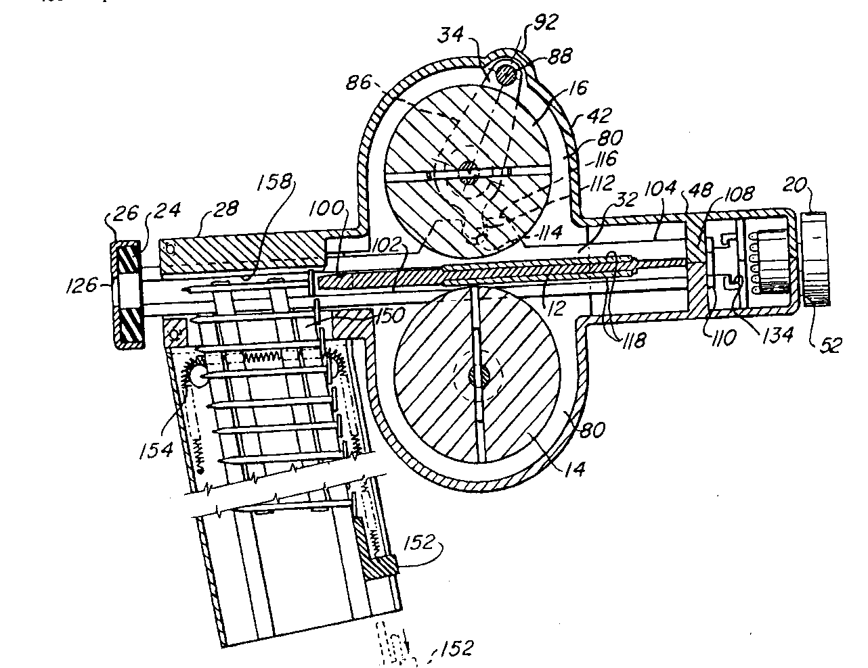

Slide 7
Common dysfunctions during concept generation
Consider only one or two alternatives
Fail to consider the usefulness of the concepts
Involve only one or two people in the process
Ineffectively integrate promising partial solutions
Fail to consider entire categories of solutions

Slide 8
Product Concept Generation Process (5 steps)
Clarify the problem
Search externally
Search internally
Explore systematically
Reflect on the solutions and the process.

Slide 9
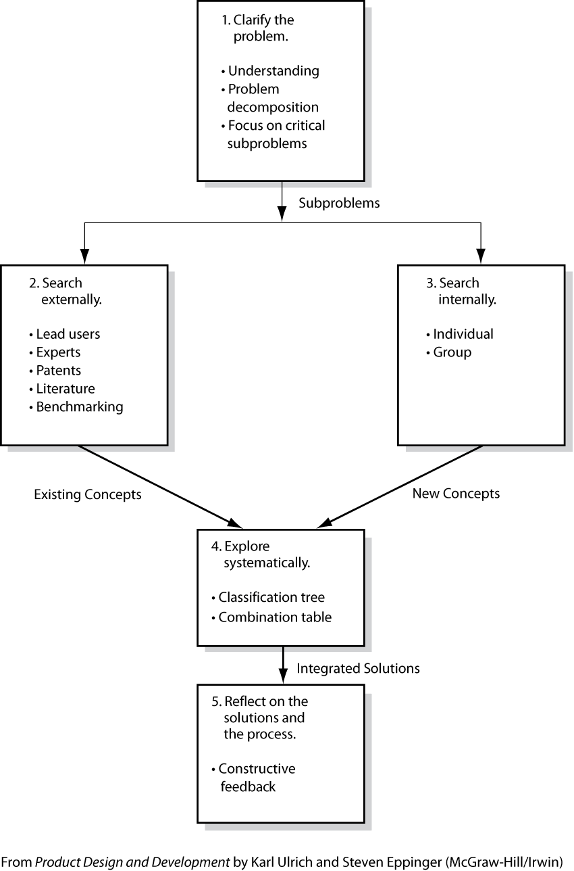

Slide 10
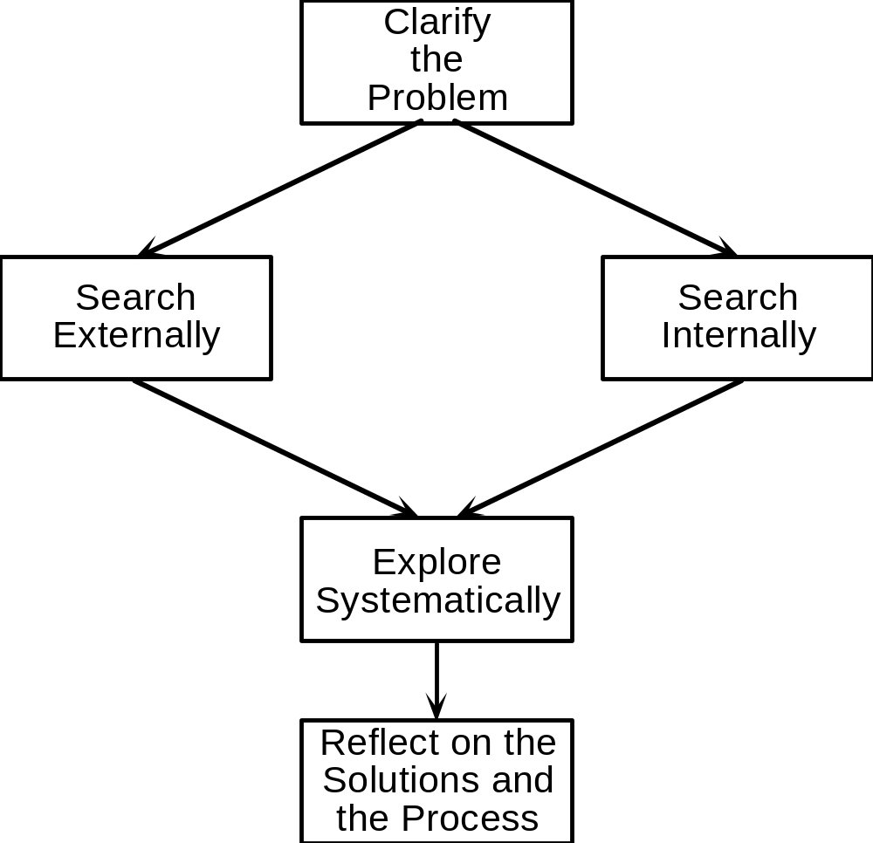
Concept Generation Process
Clarify the Problem
  Problem Decomposition
External Search
  Lead Users
  Experts
  Patents
  Literature
  Benchmarking
Internal Search
  Individual Methods
  Group Methods
Systematic Exploration
  Classification Tree
  Combination Table
Reflect on the Process
  Continuous Improvement

Slide 11
Clarify the Problem
Understand the problem
  From the team’s (product) mission statement
  From the customers needs
  From the product specifications
Decompose the problem into simpler sub-problems
  Divide and conquer
  Using function diagrams
    Decompose by sequence of user actions
    Decompose by key customer’s need
Focus initial efforts on the critical sub-problems
  Focus on critical sub-problems
  Defer solutions to other sub-problems

Slide 12
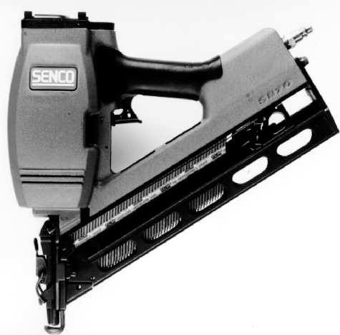

Concept Generation Example:
Power Nailer

Slide 13
Understand the Problem
From mission statement
  It will use nails
  It will be compatible with nail magazines
  It will nail through roofing singles into wood
  It will be hand held
Based on assumptions
  It inserts nails in rapid succession
  It is light weight.
  It has no nailing delays (from the user’s view)
From specifications
  Nail length ranges from 25-28 mm
  Nailing rate is 1 nail per second.
  Tool mass is less than 4 KG.

Slide 14
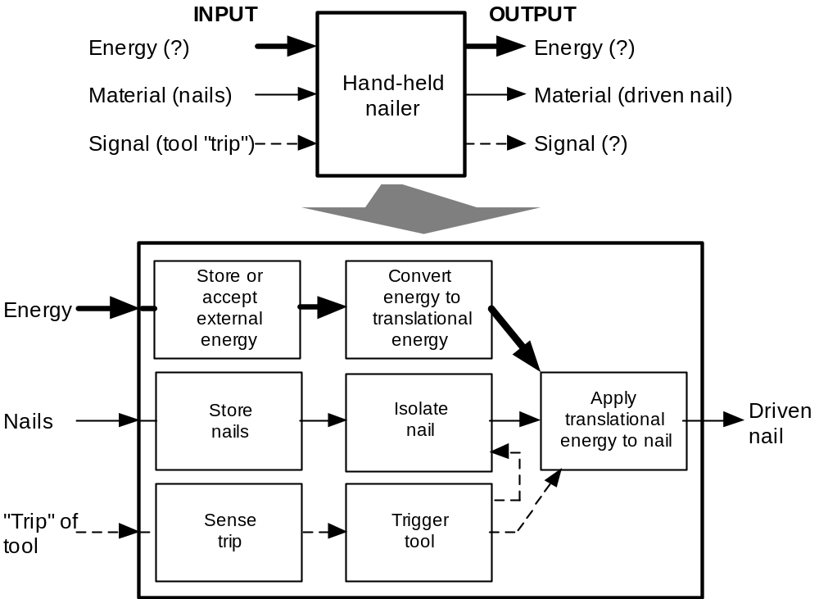
Problem Decomposition:
Function Diagram

Slide 15
Search Externally
Interview lead users
Consult experts
Search patents
Search published literature
Benchmark related products

Slide 16
External Search:
Hints for Finding Related Solutions
Lead Users
  benefit from improvement
  innovation source
Benchmarking
  competitive products
Experts
  technical experts
  experienced customers
Patents
  search related inventions
Literature
  technical journals
  trade literature

Slide 17
Search Internally (both group and individually)
Guide for the search
  Suspend judgment
  Generate a lot of ideas
  Welcome ideas that seem infeasible
  Use graphic and physical media
Hints for generating concepts
  Make analogies
  Wish and wonder
  User related stimuli
  Set quantitative goals
  Post ideas on the wall

Slide 18
Internal Search:
Hints for Generating Many Concepts
Suspend judgment
Generate a lot of ideas
Infeasible ideas are welcome
Use graphical and physical media
Make analogies
Wish and wonder
Solve the conflict
Use related stimuli
Use unrelated stimuli
Set quantitative goals
Use the gallery method
Trade ideas in a group

Slide 19
Explore Systematically
Concept combination tree
  Page 132
  Prune less promising branches
  Identify independent approaches to the problem
  Expose inappropriate emphasis on certain branches
  Refine the problem decomposition for a particular branch.
Concept combination table
  Page 113

Slide 20
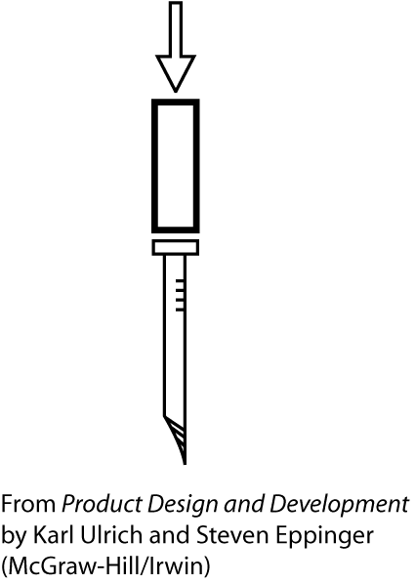

Slide 21
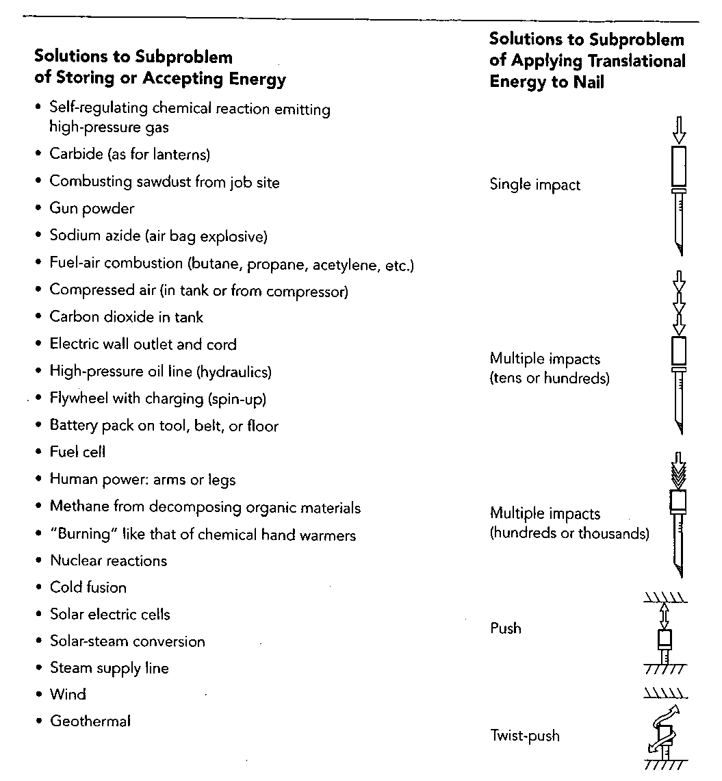

Slide 22
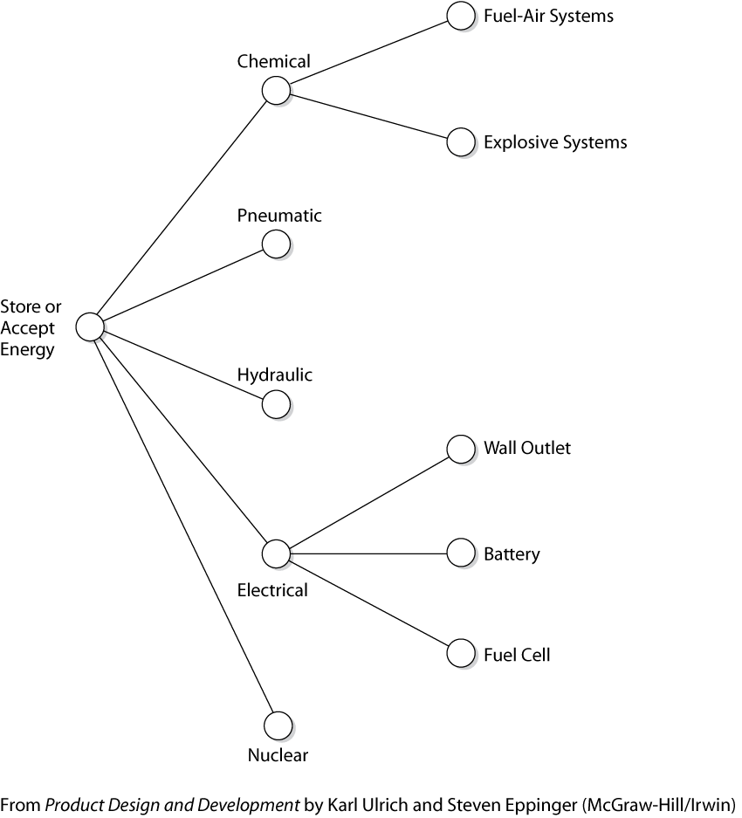

Slide 23
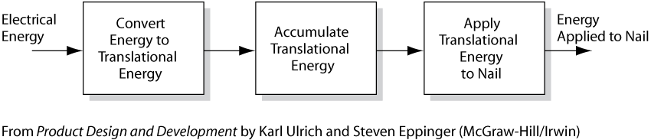

Slide 24
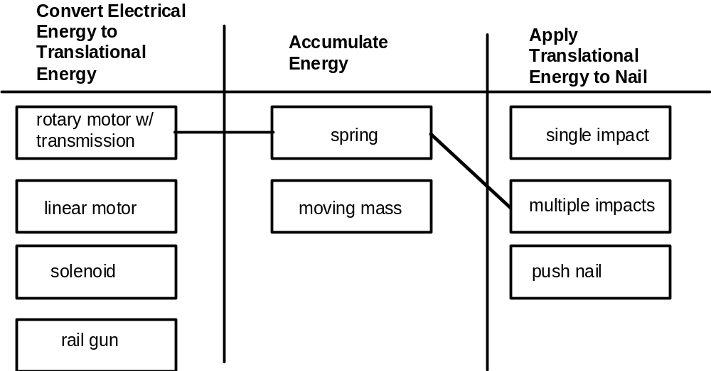
Systematic Exploration:
Concept Combination Table

Slide 25
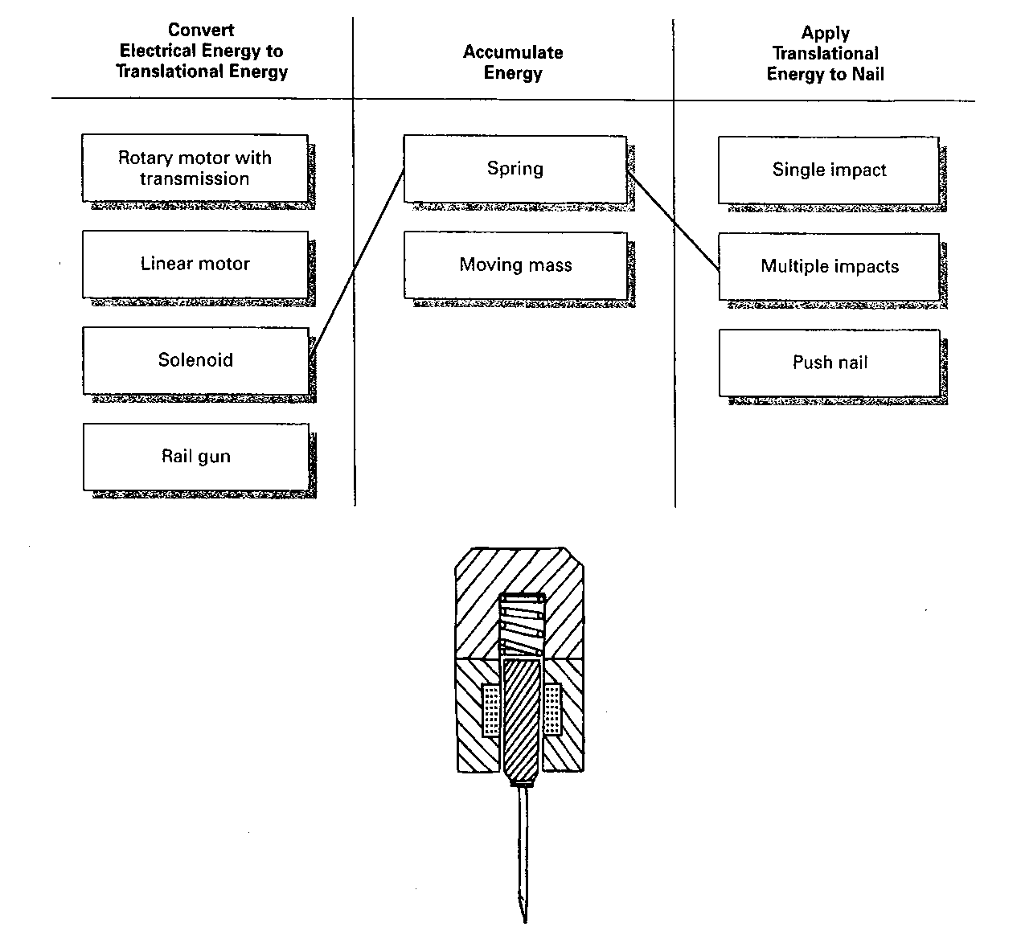

Slide 26
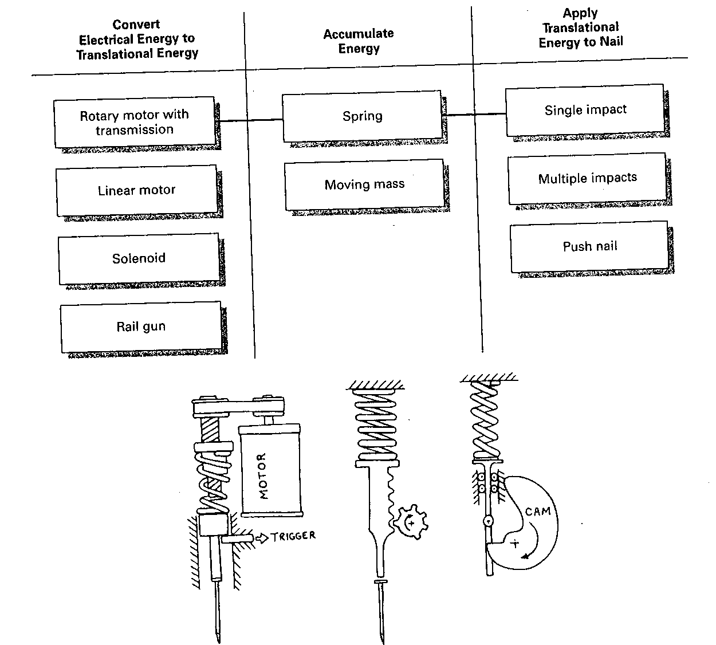

Slide 27
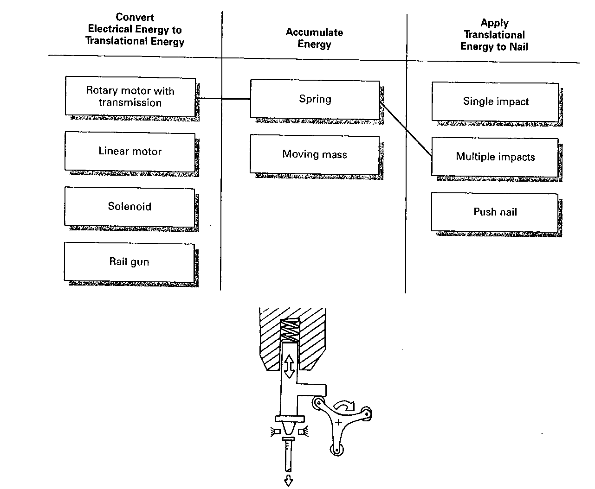

Slide 28
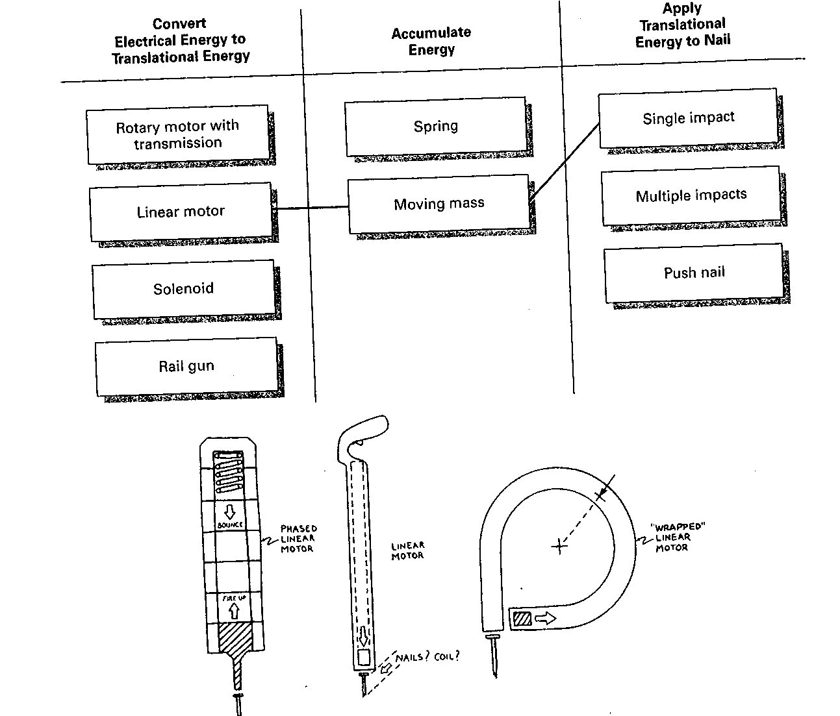

Slide 30
Concept Generation Example:
Power Nailer

Slide 31
Reflect on the Results
  The solution space?
  Alternative function diagrams?
  Alternative ways to decompose the problem?
  Additional external resources?
  All ideas generated and integrated?

Slide 32
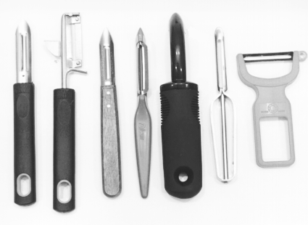
Concept Generation Exercise:
Vegetable Peelers

Slide 33
Vegetable Peeler Exercise:
Voice of the Customer
"Carrots and potatoes are very different."
"I cut myself with this one."
"I just leave the skin on."
"I'm left-handed. I use a knife."
"This one is fast, but it takes a lot off."
"How do you peel a squash?"
"Here's a rusty one."
"This looked OK in the store."

Slide 34
Vegetable Peeler Exercise:
Key Customer Needs
1. The peeler peels a variety of produce.
2. The peeler can be used ambidextrously.
3. The peeler creates minimal waste.
4. The peeler saves time.
5. The peeler is durable.
6. The peeler is easy to clean.
7. The peeler is safe to use and store.
8. The peeler is comfortable to use.
9. The peeler stays sharp or can be easily sharpened.

Slide 35
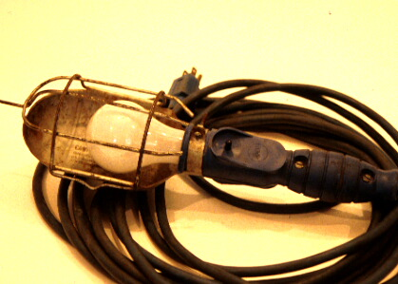
Capture Innovation from Lead Users:
Utility Light Example

Slide 36
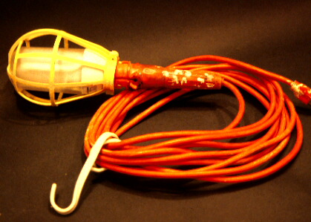
Capture Innovation from Lead Users:
Utility Light Example

Slide 37
Other Images

Slide 38

Concept Generation Example:
Power Nailer

Slide 39
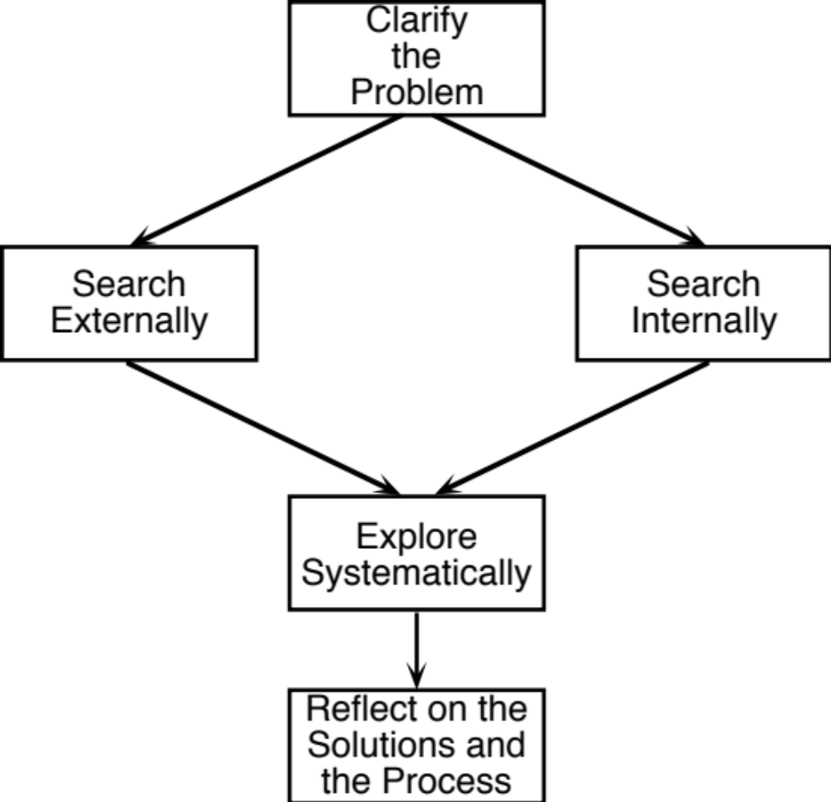
Concept Generation Process
Clarify the Problem
  Problem Decomposition
External Search
  Lead Users
  Experts
  Patents
  Literature
  Benchmarking
Internal Search
  Individual Methods
  Group Methods
Systematic Exploration
  Classification Tree
  Combination Table
Reflect on the Process
  Continuous Improvement

Slide 40
Concept Generation Exercise:
Vegetable Peelers

Slide 41
Vegetable Peeler Exercise:
Voice of the Customer
"Carrots and potatoes are very different."
"I cut myself with this one."
"I just leave the skin on."
"I'm left-handed. I use a knife."
"This one is fast, but it takes a lot off."
"How do you peel a squash?"
"Here's a rusty one."
"This looked OK in the store."

Slide 42
Vegetable Peeler Exercise:
Key Customer Needs
1. The peeler peels a variety of produce.
2. The peeler can be used ambidextrously.
3. The peeler creates minimal waste.
4. The peeler saves time.
5. The peeler is durable.
6. The peeler is easy to clean.
7. The peeler is safe to use and store.
8. The peeler is comfortable to use.
9. The peeler stays sharp or can be easily sharpened.

Slide 43
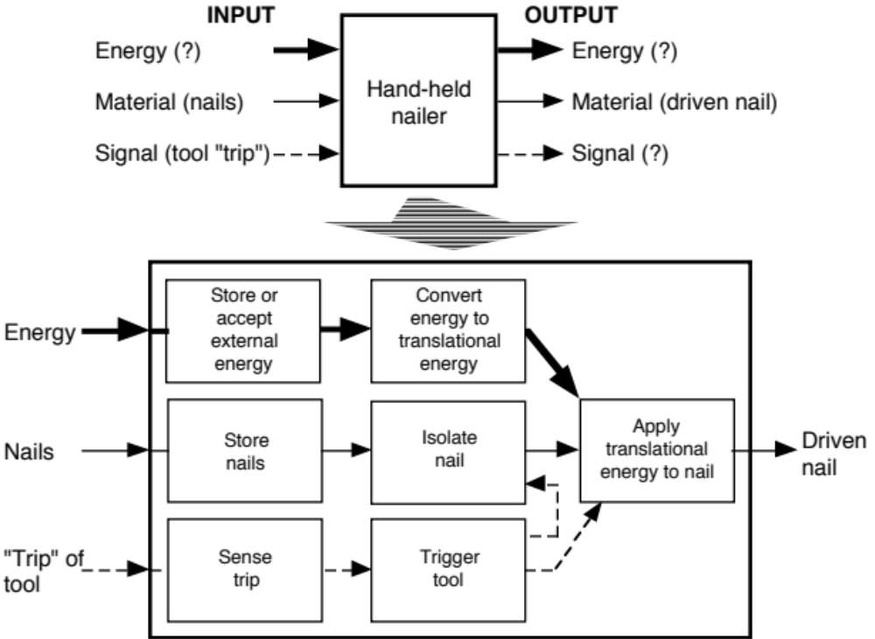
Problem Decomposition:
Function Diagram

Slide 44
External Search:
Hints for Finding Related Solutions
Lead Users
  benefit from improvement
  innovation source
Benchmarking
  competitive products
Experts
  technical experts
  experienced customers
Patents
  search related inventions
Literature
  technical journals
  trade literature

Slide 45
Capture Innovation from Lead Users:
Utility Light Example

Slide 46
Capture Innovation from Lead Users:
Utility Light Example

Slide 47
Internal Search:
Hints for Generating Many Concepts
Suspend judgment
Generate a lot of ideas
Infeasible ideas are welcome
Use graphical and physical media
Make analogies
Wish and wonder
Solve the conflict
Use related stimuli
Use unrelated stimuli
Set quantitative goals
Use the gallery method
Trade ideas in a group

Slide 48

Systematic Exploration:
Concept Combination Table

Slide 49
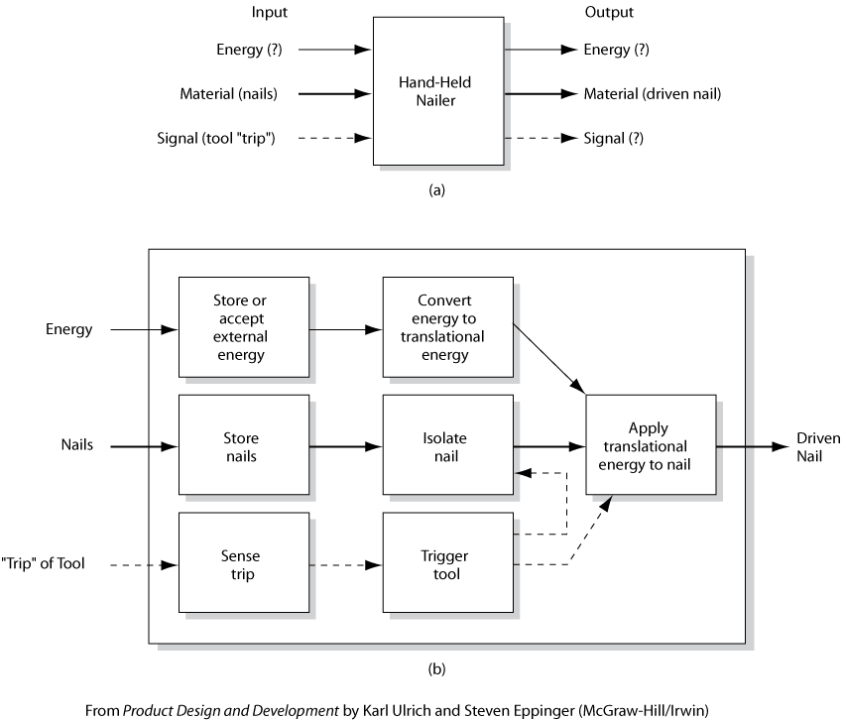

Slide 50
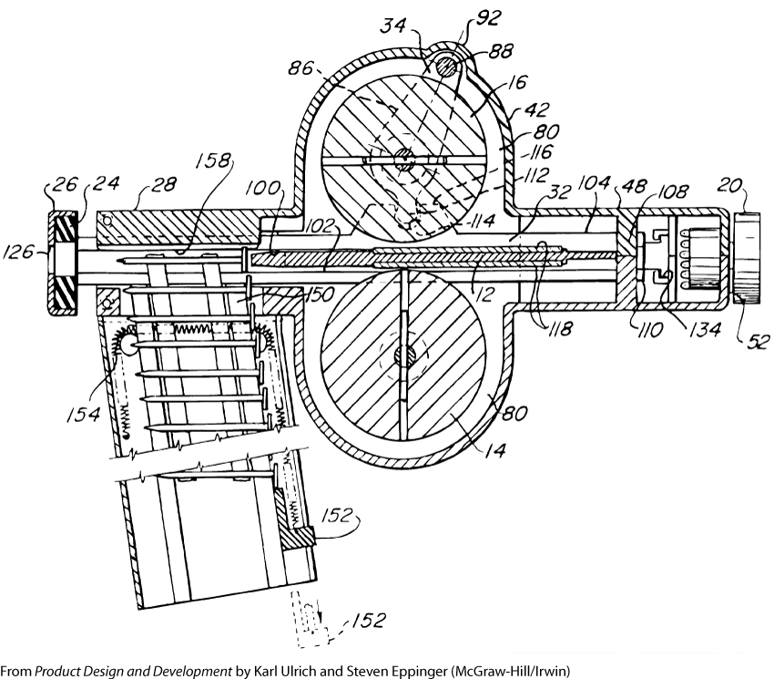

Slide 51
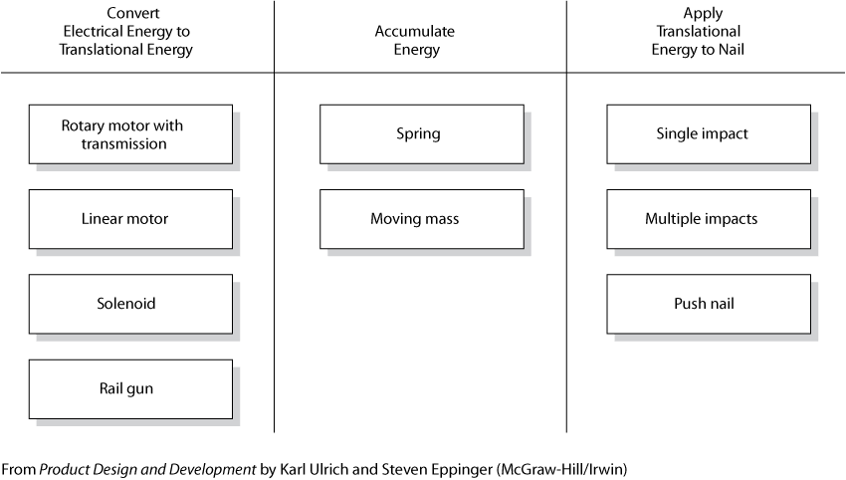

Slide 52
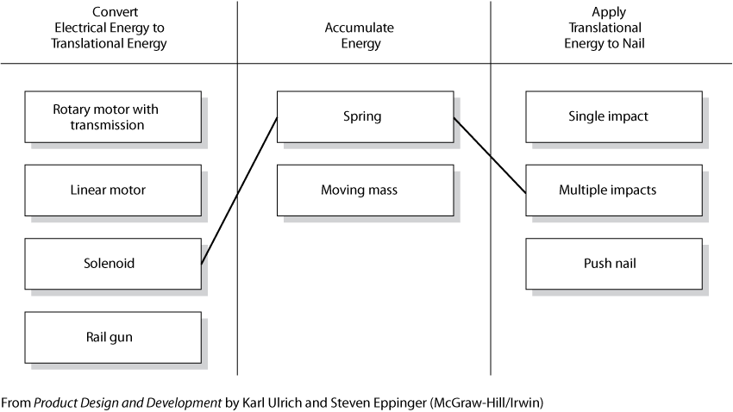

Slide 53
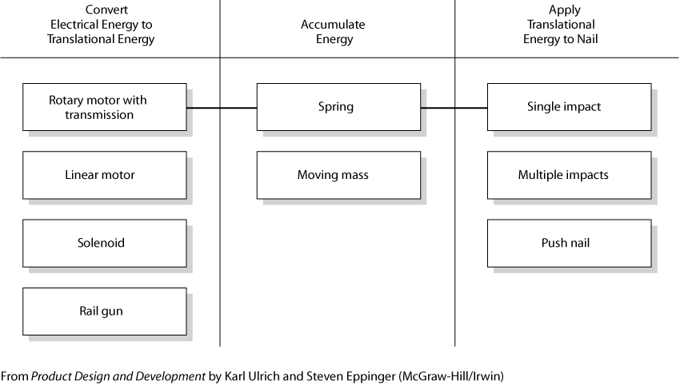

Slide 54
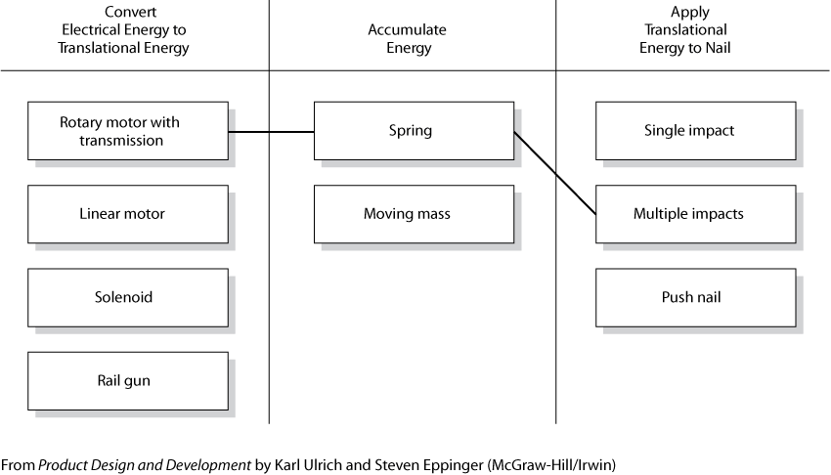

Slide 55
